Slide 1


27 Feb 2026
IEEE HackConquest 2.0
Round 1 – Ideation & Problem Understanding

Slide 2
Problem Statement
Understanding the key challenges and stakeholders

Slide 3
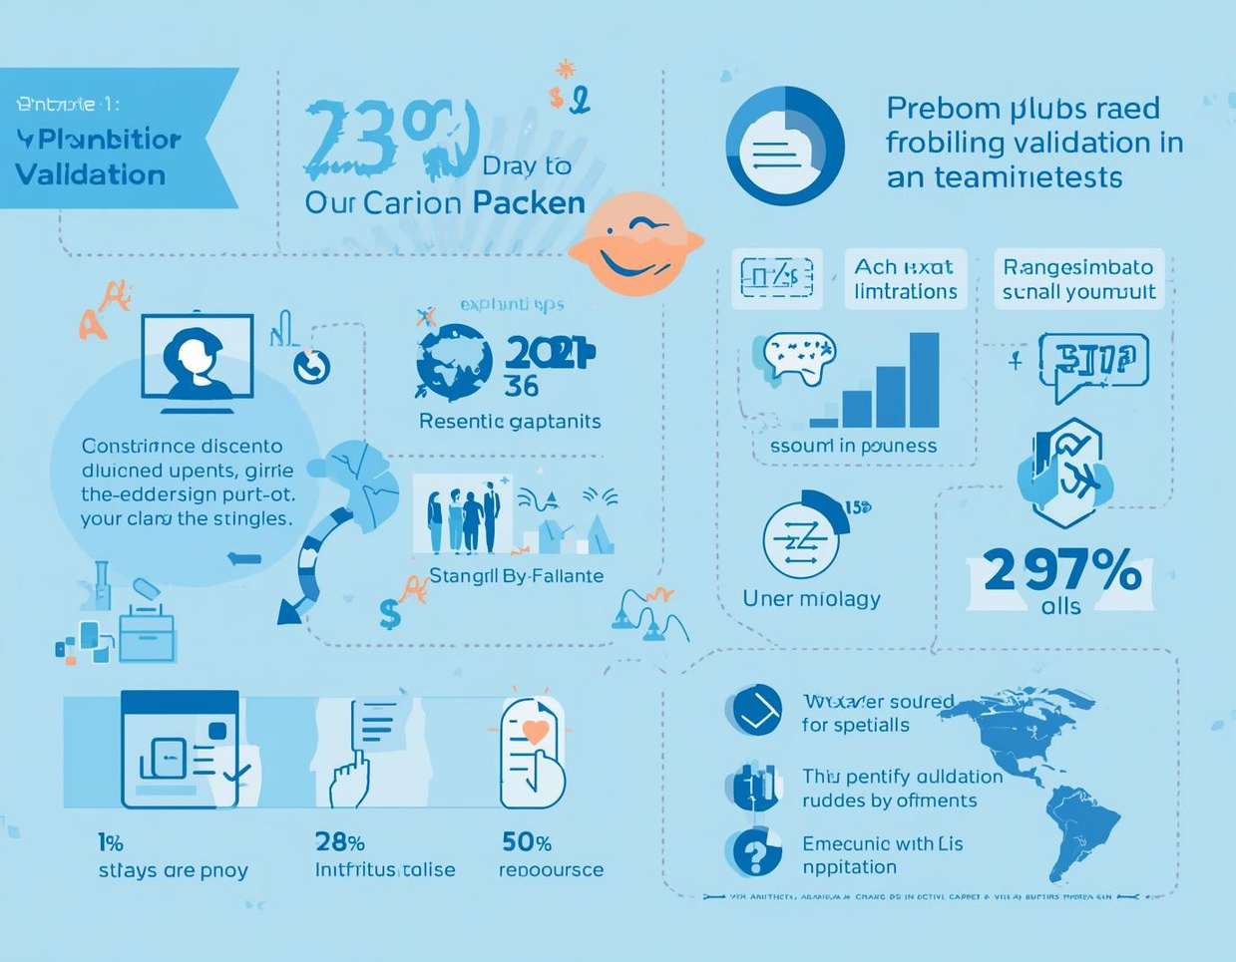
Problem Validation and Evidence
Confirming the Existence of the Problem
Recent surveys reveal significant concerns among users regarding the issue.

Slide 4

Competitive Landscape Overview
Unique Selling Proposition
Identified key competitors in the market
Evaluation of their strengths and weaknesses
Comparison of features: pricing, technology used, and accessibility
Opportunities for improvement within the current market
Gaps in service offerings that our solution can address
Our solution stands out by offering:
Innovative technology not offered by competitors
Enhanced user experience through simplified interfaces
Cost-effective solutions tailored for target demographics
Superior customer support and engagement strategies
Accessibility features that broaden user reach

Slide 5
Innovation Highlights
Key aspects of our solution
Utilizes cutting-edge AI technology
User-friendly interface for accessibility
Eco-friendly materials for sustainability
Real-time data analytics integration

Slide 6

Impact Assessment
Our solution offers significant environmental benefits, enhancing sustainability and improving quality of life for communities involved.

Slide 7
Feasibility
Assessing Technical and Practical Viability
Our project leverages cutting-edge technology, combined with our team's expertise, ensuring effective implementation and scalability to meet user needs and adapt to market demands.

Slide 8
Implementation Timeline
Research
Design
Development
Testing
Conduct preliminary surveys and gather initial insights.
Develop prototypes based on user feedback and findings.
Build the final product using the chosen technology.
Perform rigorous testing to ensure functionality and quality.

Slide 9

Risk Analysis
Identifying challenges and their solutions
Technical Risks
Market Risks
Operational Risks
The technology may not perform as expected, leading to project delays. Regular testing and prototyping can mitigate this risk effectively.
Competition may undermine our market entry, impacting user adoption. Conducting thorough market research and refining our value proposition can help address this challenge.
Resource shortages or team member turnover could disrupt progress. Establishing strong partnerships and a clear resource management plan can minimize this risk significantly.

Slide 10


Team Members and Their Roles
Project Lead
Developer
Responsible for overall project management and coordination.
Builds and implements the technical aspects of the project.

Slide 11

Conclusion
Our innovative solution addresses critical needs, ensuring both feasibility and a positive impact for stakeholders moving forward.

Slide 12
Questions?
Feel free to reach out for more information

